Slide 1

Thinking Like a Scientist
Tom Carpenter, PhD
Stephen Elston, PhD

Slide 2
Premise
Very smart data scientists answering research questions at Microsoft
Share insights from professional science into research for “understanding” people
Notes:
Using data to predict and answer questions about people, behavior

Slide 3

Tom Carpenter, PhD
Research & Statistical Consultant
Associate Professor, Psychology @ Seattle Pacific U.
Notes:
Expertise:
Statistical modeling and computing
Research design and methodology
Human psychology (emotion, bias, consumer behavior)

Slide 4
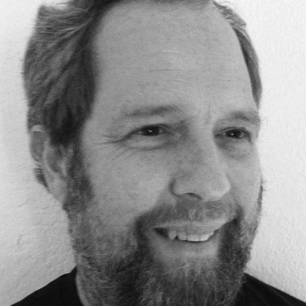
Stephen F. Elston, PhD
Principle Consultant, Founder at Quantia Analytics LLC
Instructor in data science, machine learning and AI at U. of Washington, Harvard Extension School
And
Data Science and machine learning consultant

